Slide 1
Quantum Mechanics
Tutorial

Slide 2
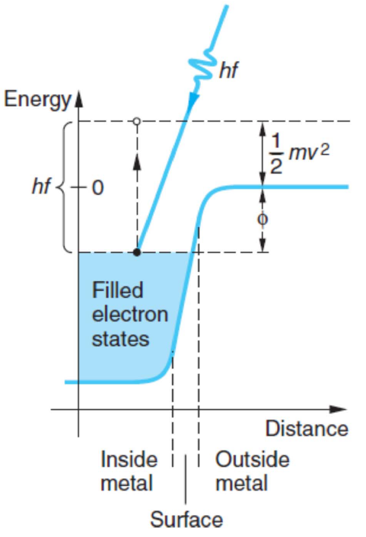
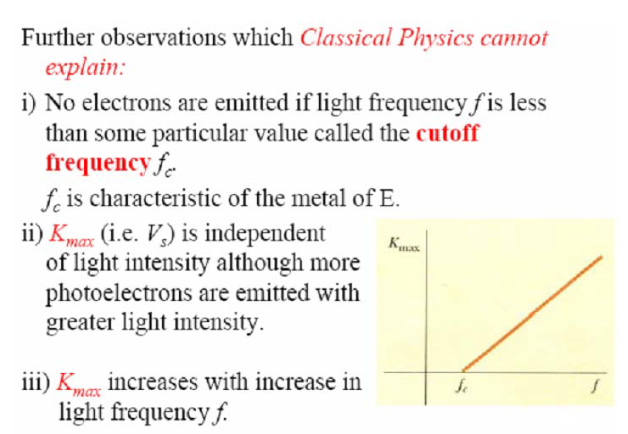

Photoelectric effect

Slide 3
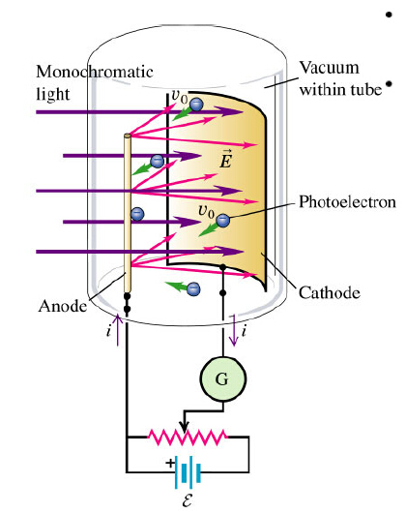
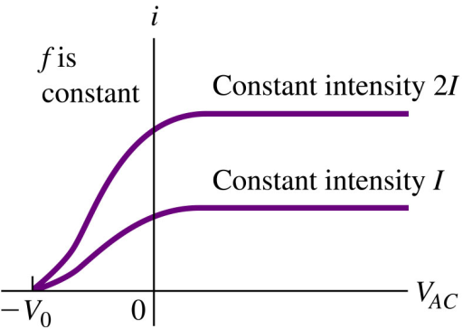
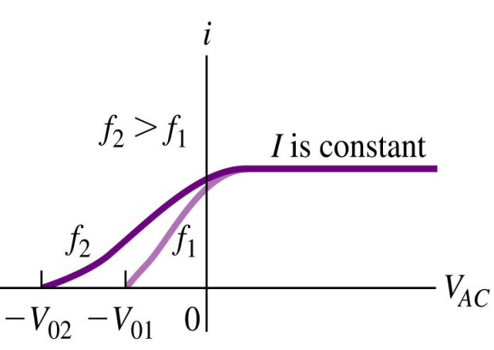
Review of Ch38
Photoelectric effect
Ch38-3

Slide 4

单选题
10分
The work function for a certain sample is 2.3 eV. The stopping potential for electrons ejected from the sample by 7.0 ×10¹⁴ Hz electromagnetic radiation is:
A) 0 V
B) 0.60 V
C) 2.3 V
D) 2.9 V
E) 5.2 V
A
B
C
D
E
提交

Slide 5
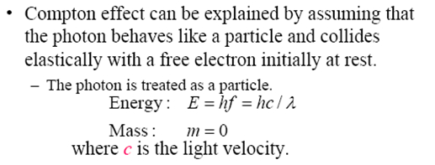
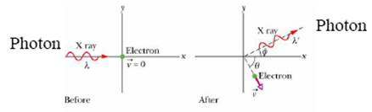
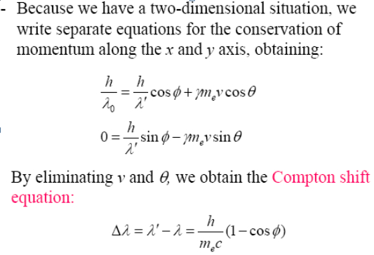
Compton effect
along x
along y

Slide 6
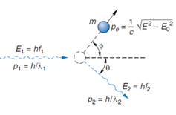
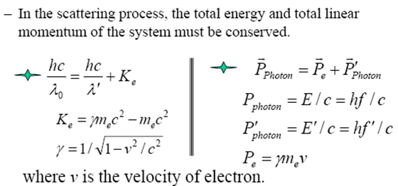
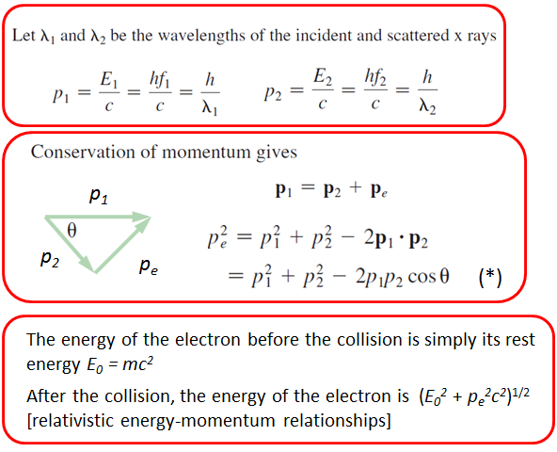
Compton effect

Slide 7
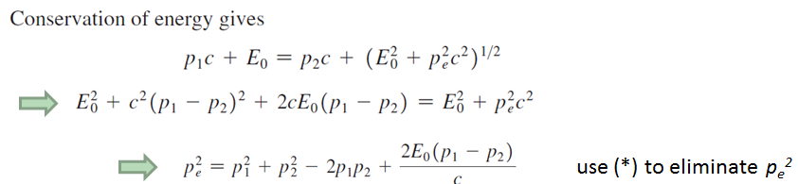
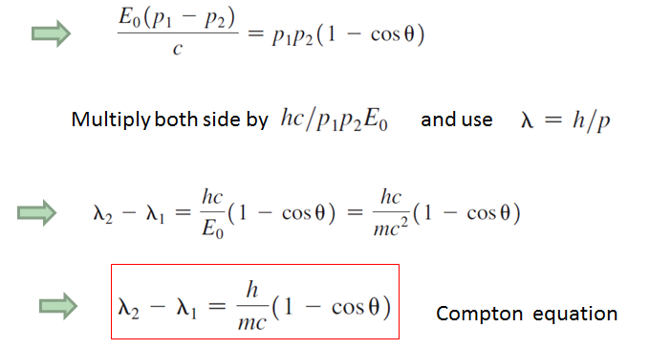
Compton effect

Slide 8

problem
Show that when a photon of energy E is scattered from a free electron at rest, the maximum kinetic energy of the recoiling electron is given by
Ch38-13

Slide 9
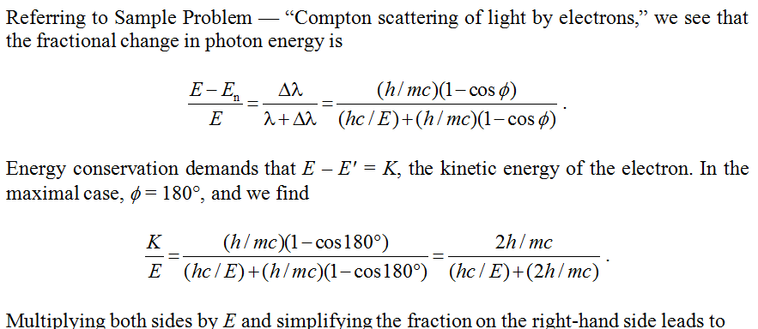

Answer
Ch38-14

Slide 10
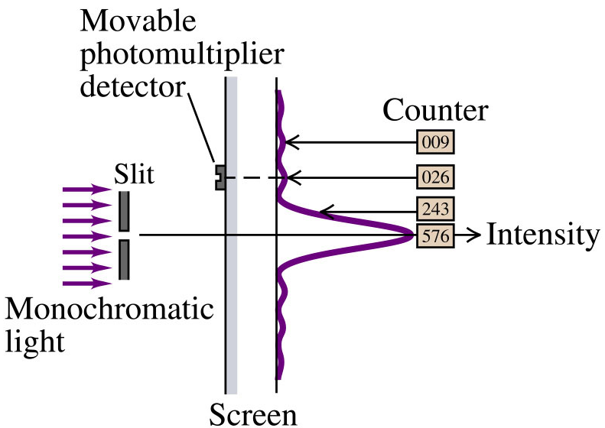


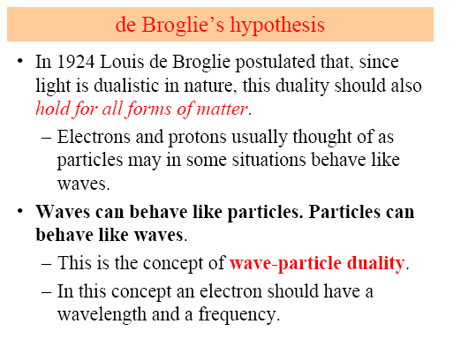

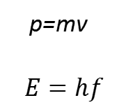
Wave Particle Duality
$$\text{p}\text{=}\text{mv}$$
$$E=hf$$

Slide 11





Wave Function

Slide 12
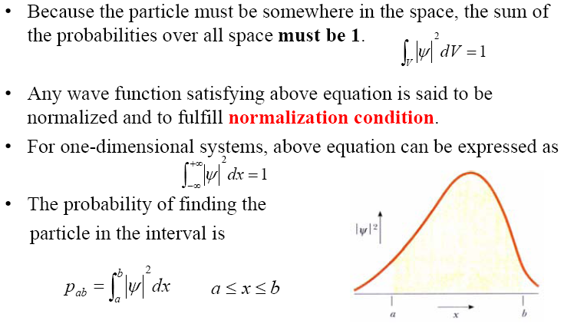
Wave Function

Slide 13
Wave Function

Slide 14
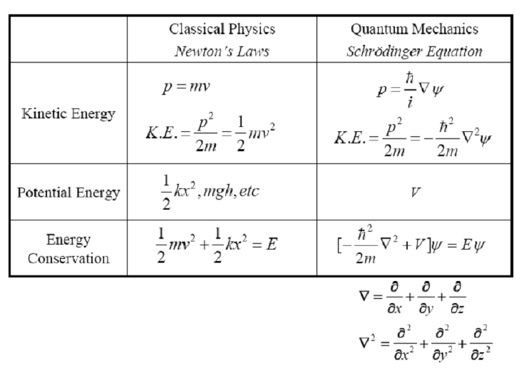
Schrodinger Equation

Slide 15
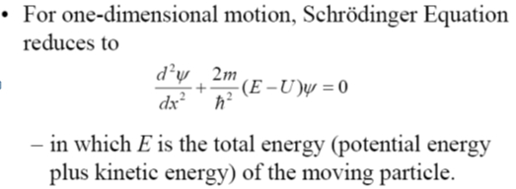
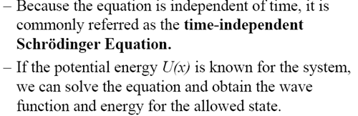
Schrodinger Equation

Slide 16
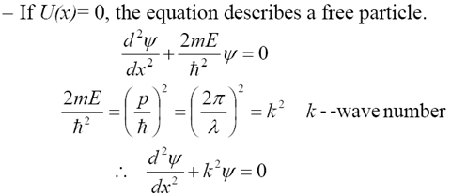



Schrodinger Equation
k--angular wave number
General solution

Slide 17
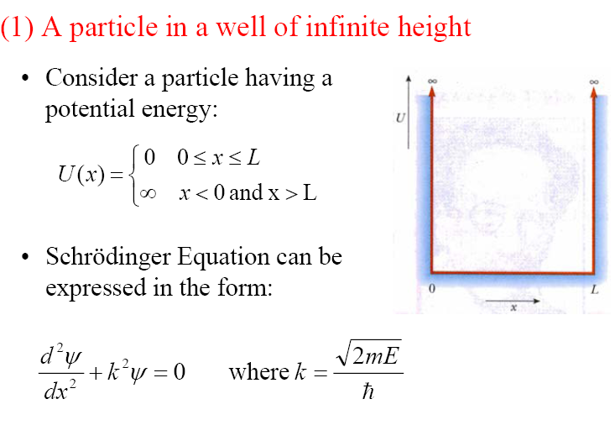
Example

Slide 18
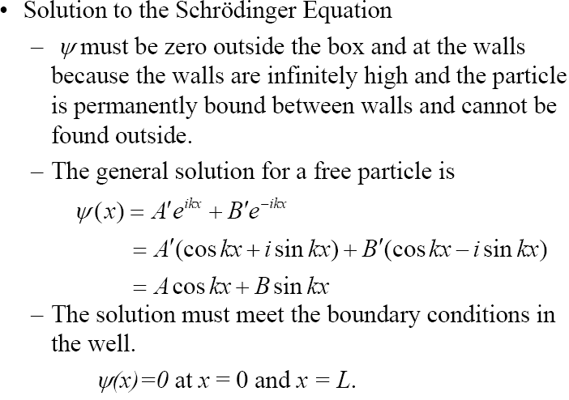
Example

Slide 19
Example
L

Slide 20
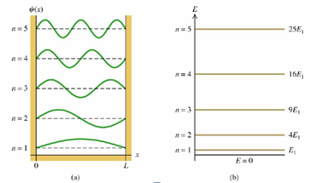
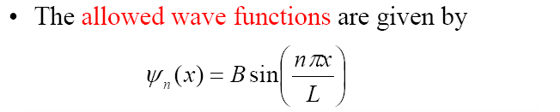
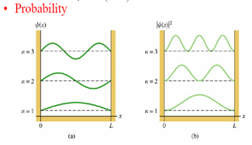
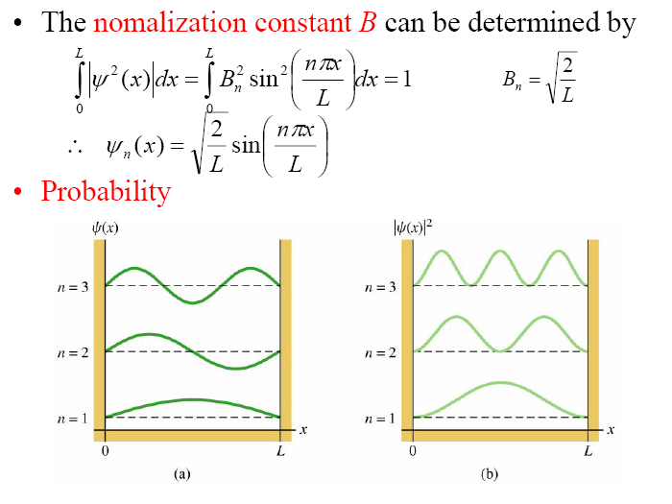
Example

Slide 21
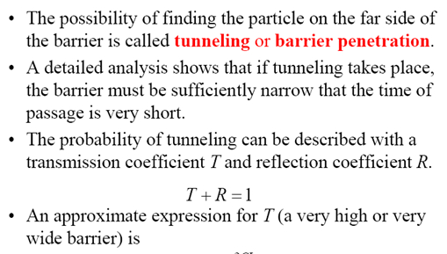


Barrier Tunneling
Ch38-12

Slide 22

Problem
The second-excited state
3πx
And how about the middle 1/3 , right 1/3 of the well?

Slide 23
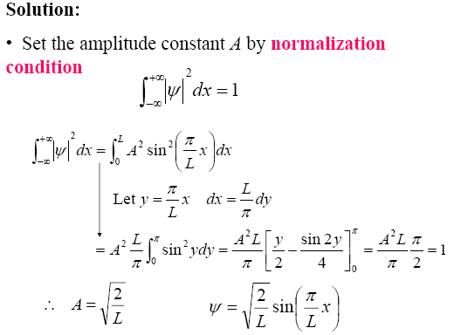







Answer

Slide 24
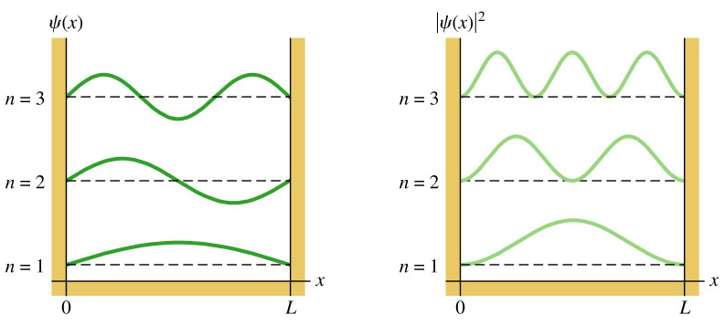
Probability of detection in left one-third of well
We can find the probabilities of detection in middle and right one-third of well
also are 1/3 via pluging (π, 2π) and (2π, 3π) into the bounds of integration.

Slide 25

Problem
2. A particle moving in one dimension (the x-axis) is described by the wave function
Where b = 2.00 m⁻¹, A > 0, and the +x-axis points toward the right.
(a) Determine A so that the wave function is normalized
(b) Sketch the graph of the wave function.
(c) Find the probability of finding this particle from -50.0 cm to +50cm
Ch38-15

Slide 26


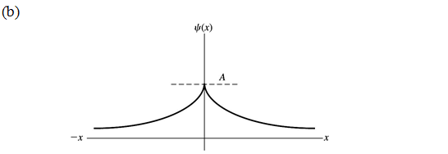
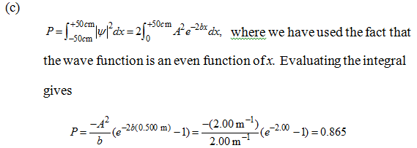
Answer
Ch38-16

Slide 27
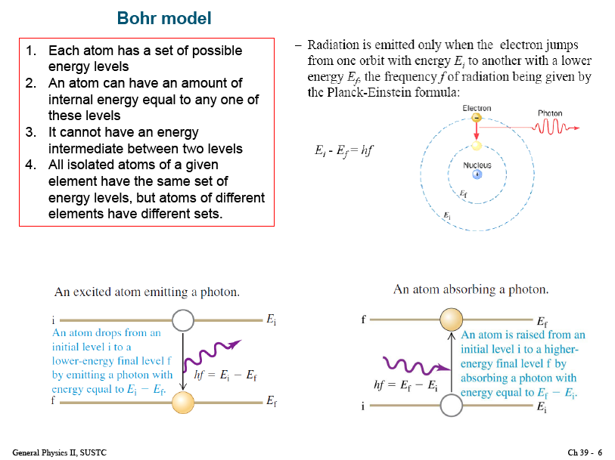

Slide 30
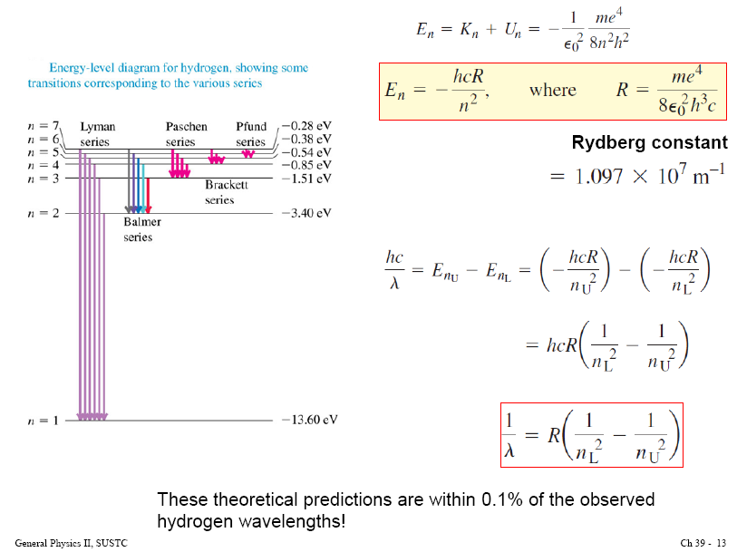

Slide 31
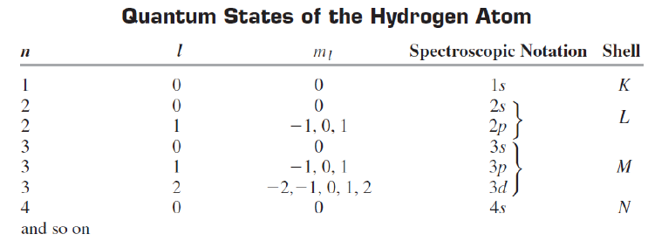
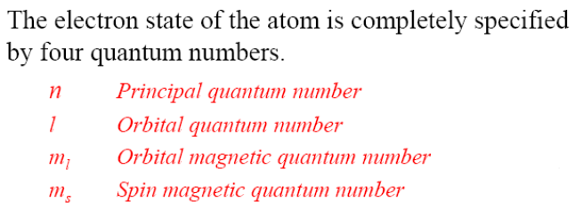

Slide 32

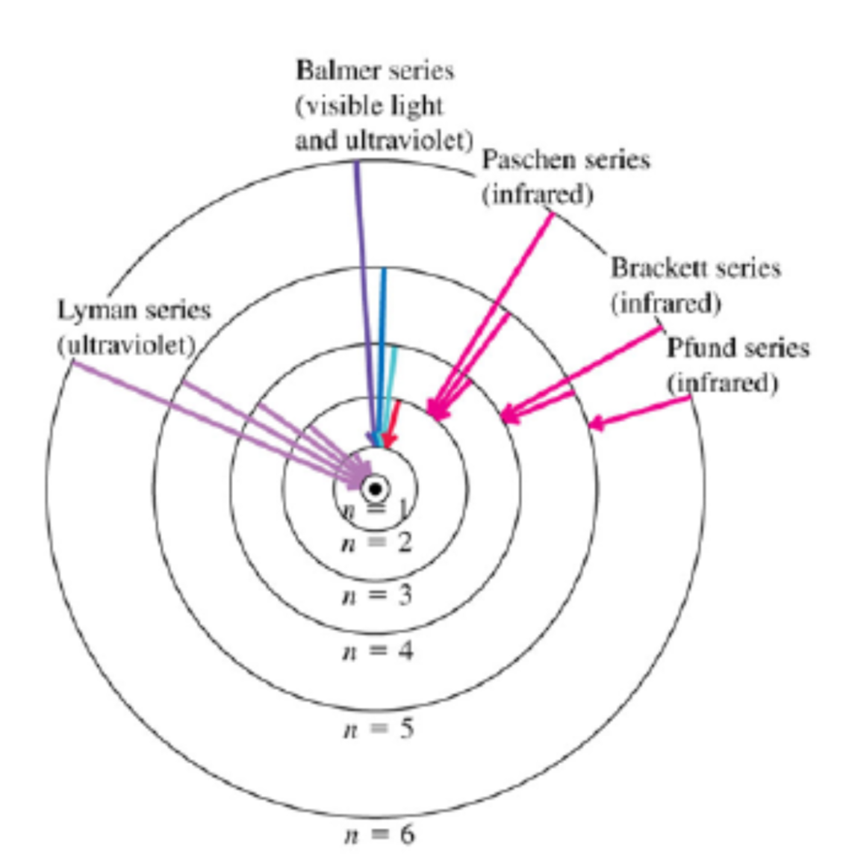
Problem

Slide 33




Solution
(a)
12
max
12
min
min

Slide 34

Solution
(c)

